Slide 1


SOMERSET PURPOSE
Somerset Academy, Inc. promotes a transformational culture that maximizes student achievement and the development of accountable, global learners in a safe and enriching environment that fosters high-quality education.
S - Set high expectations
O - Objective
M - Meaningful curriculum
E - Effective
R - Resourceful and responsible life long learners
S - Scholars who achieve proficiency and beyond
E - Evaluate continuously and use data to drive curriculum
T - Teachers who are highly qualified

Slide 2

DO NOT. . .
“Hang out” in the stairwells or on the second floor during lunch.
Chew gum. DO NOT BRING GUM!
Go on the basketball court with a skateboard!
Use the elevator without approval from the office.
Leave campus if you are a Middle Schooler, Freshman or Sophomore (Except for DE students)
Allow an underclassmen in your vehicle without prior permission, or you will lose all privileges for the remainder of the school year.
Throw anything off the balcony.
Throw anything from the ground level to the 2nd floor.
Eat or carry food over the basketball court or turf field
Litter or leave garbage around at lunch
Hang out by the wavy wall side or behind the basketball court bleachers
Hang on or grab the basketball nets/rims
Playing “keep away” = a detention
Yoga pants/ leggings/ are not allowed. Not even during dress down days. Dress code violations earn detentions
You are not to go to the Deans’ office during class to argue a detention. You will be turned away.

Slide 3
Discipline
Discipline is applied with mutual respect in a firm, fair , reasonable and consistent manner.
Preventive Morning announcements, Teacher and School's Rules & Expectations
Supportive Warnings for students to get back on task. Email notification to parents
Corrective Weekly Monday Detentions, Monthly Saturday Detentions

Slide 4
Somerset College Prep Discipline Matrix
*Warnings* Do Not apply to all discipline. Teacher & Staff discretion
DETENTION
SATURDAY DETENTION
SUSPENSION including DISMISSAL
3:50 to 4:50pm
Classroom Disruption
Disruptive Conduct
Chewing Gum
Bus Violation
Disrespect for others
Disrespect for property
Littering during lunch
Electronic Confiscation
Public Display of Affection / P.D.A
Profane Obscene Abusive Language
Running in the Halls
Spray used in the Restrooms
Tardy to Class
Tardy to School ( 3 late arrivals non bus rider)
9:30 to 12:30pm
Horseplay
Missed Detention
Multiple Detentions
Disruptive Conduct
Bus Violation
Skipping = 2 Saturday Detentions, Referral & 9 week Behavior Probation Contract
Cheating = 3 Saturday Detentions, Referral & Behavior Probation Contract
Excessive Detentions / Unserved Detention
Theft
False or Misleading Info
Open Defiance of Authority
Vaping
Physical Altercation
Fighting or Attempting to Fight
Assault / Intimidation Threat of Student
Weapons
Other Major Misconduct

Slide 5
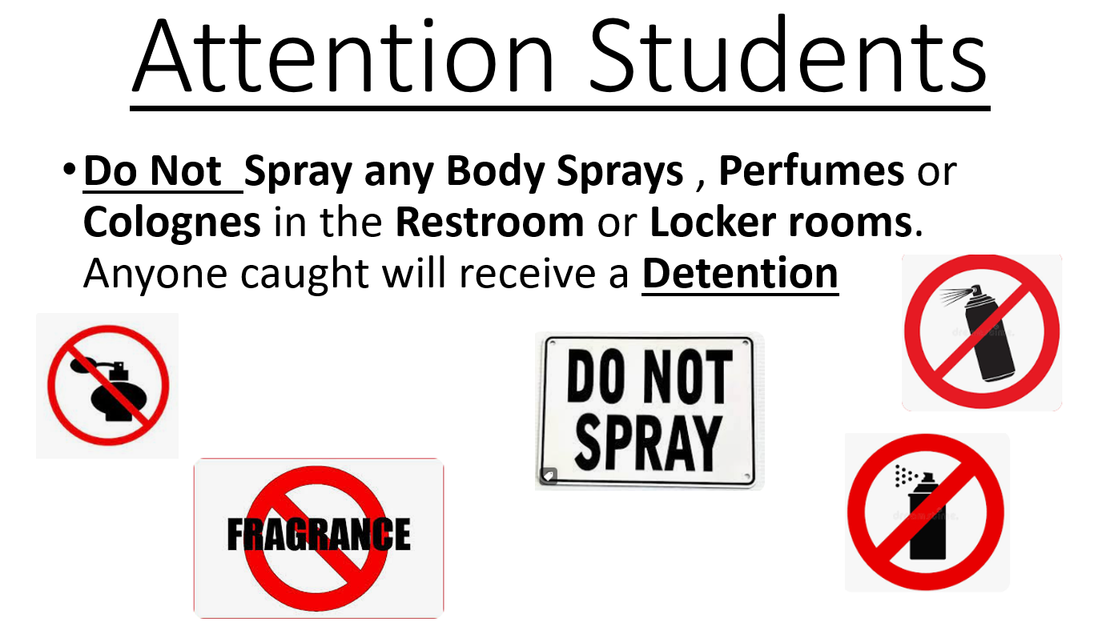

Slide 6

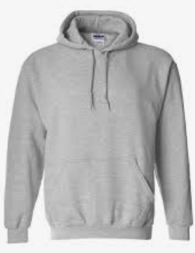
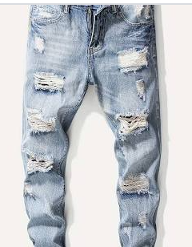
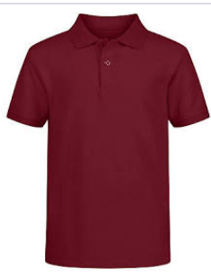
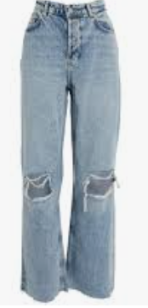
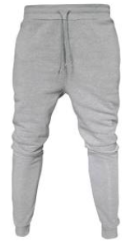
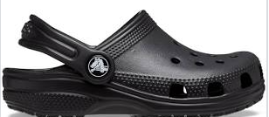

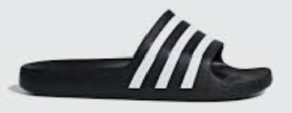

Dress Code Violations (Do Not Wear)
Ripped or Frayed Jeans
Non - Somerset, Hoodies or Polos
Crocs, Slides & Foam Runners
Sweatpants, Joggers, Yoga pants, tights or Pajama pants

Slide 7
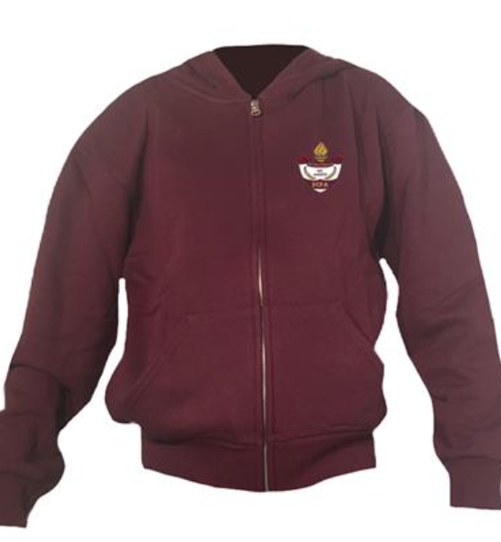

Dress Code Violations
A Somerset College Prep shirt must be worn underneath a zip up Hoodie or Jacket.
Exceptions would include
House Shirts on Thursday's
School Friday Shirts
Club Shirts
School Athletic apparel for game days.
Anyone not in compliance will be given a Dress Code Violation according to our Discipline Matrix.

Slide 8
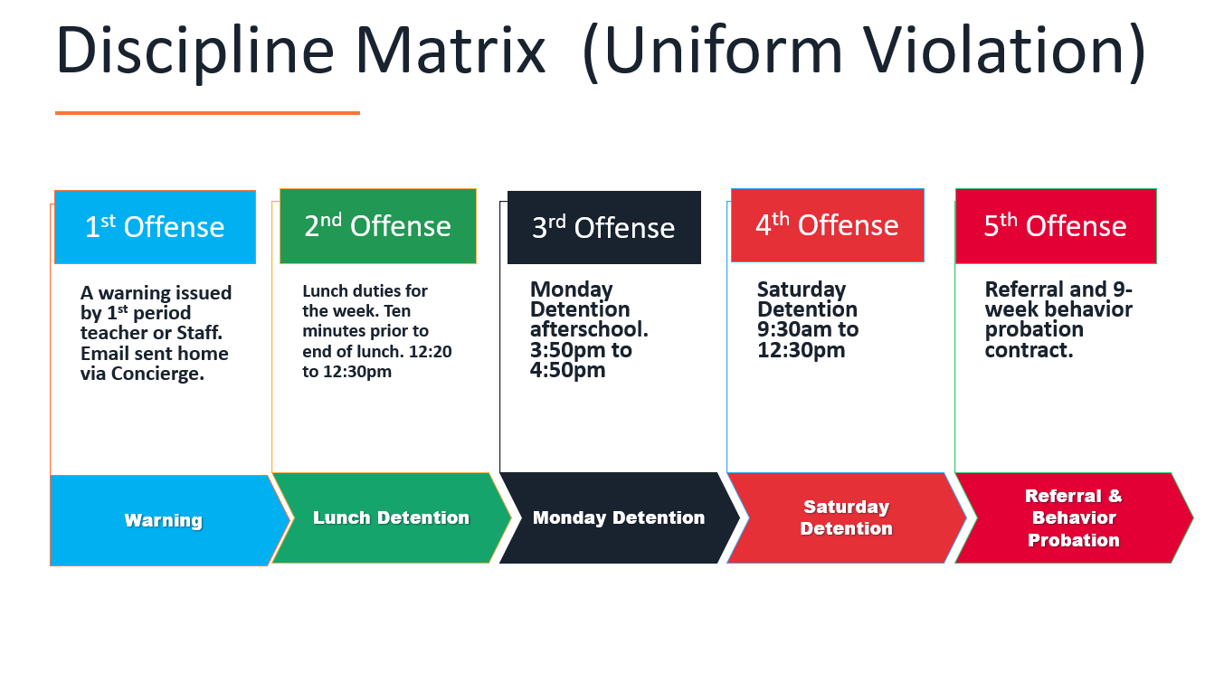

Slide 9
Dress Code (What can I wear)
School Appropriate Attire
OK
Solid Color Shorts (Fingertip length or longer)
Denim, Khaki, Cargo & Jean Shorts
House Shirts
Club Shirts
Skorts, Capris Any color
Not OK
Spandex Material
Rips , Tears or Frays
Sweatpants, Yoga pants
Tank tops
Leggings
Bottoms with print or derogatory slogans

Slide 10
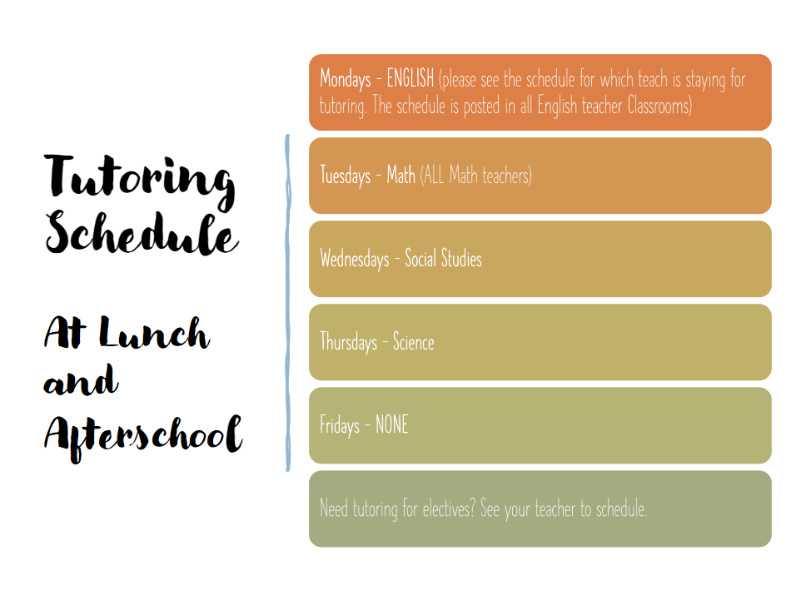

Slide 11

Tardy—being late to class.
Being tardy to periods 2, 3, or 4 is accompanied by a detention.
Period 2, 3, 4 teachers write & submit the detention.
Being tardy to 1st period is a detention if you are a bus rider and your bus was on time.
Being tardy to 1st period and you are not a bus rider is a detention for every 3rd occurrence.
*Does not apply to excused tardies.

Slide 12
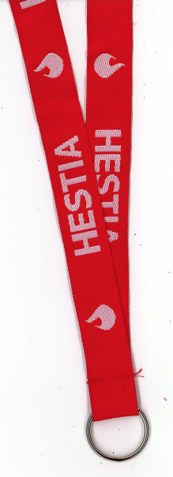
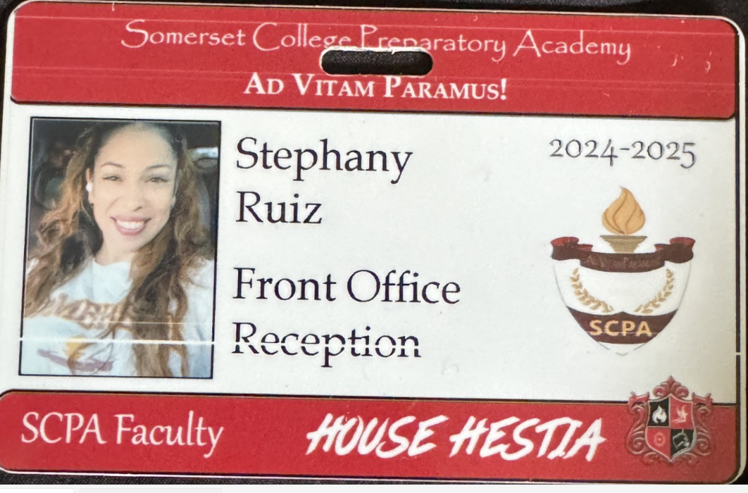
Lanyards and IDs are a Mandatory
Part of your uniform
Keep in your backpack
Needs to be worn everyday you’re at school
No Lanyard and ID will result in a dress code violation.
Purchase in Front Office
Lanyard $3
ID $2 (Cash Only)

Slide 13





No Sports on Turf Afterschool without a Coach

Slide 14
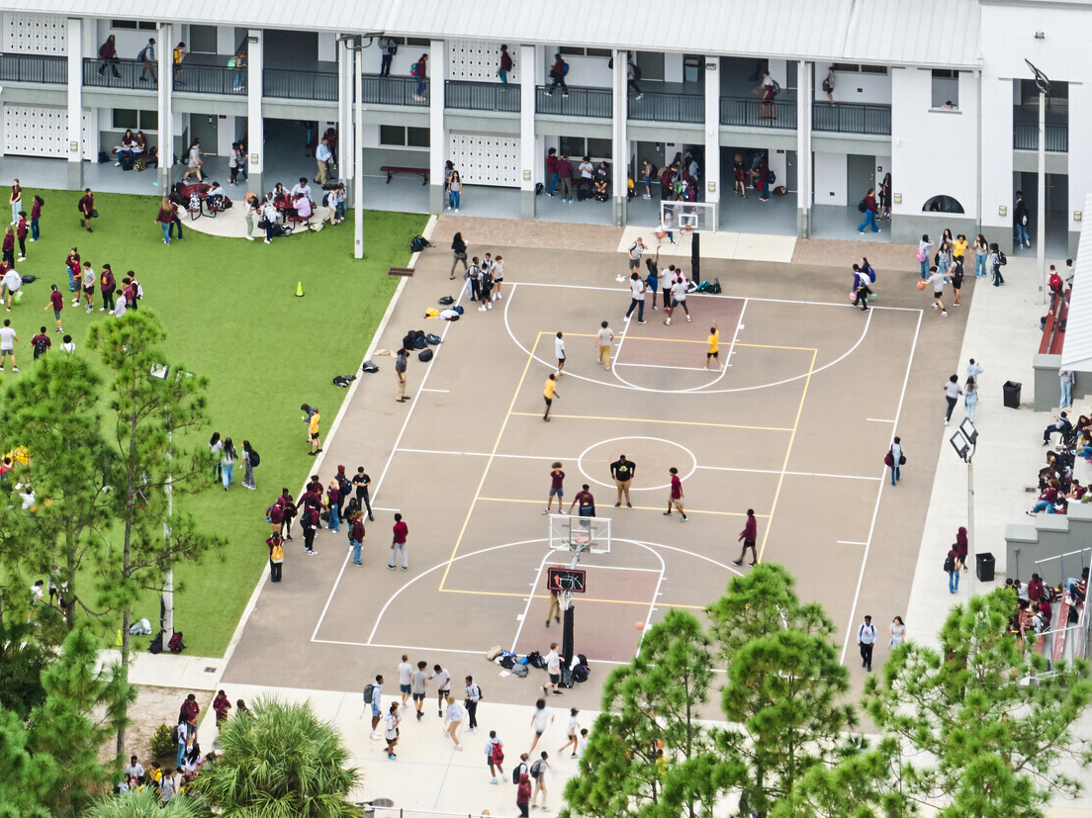
NO FOOD or drink ON THE COURT

Slide 15
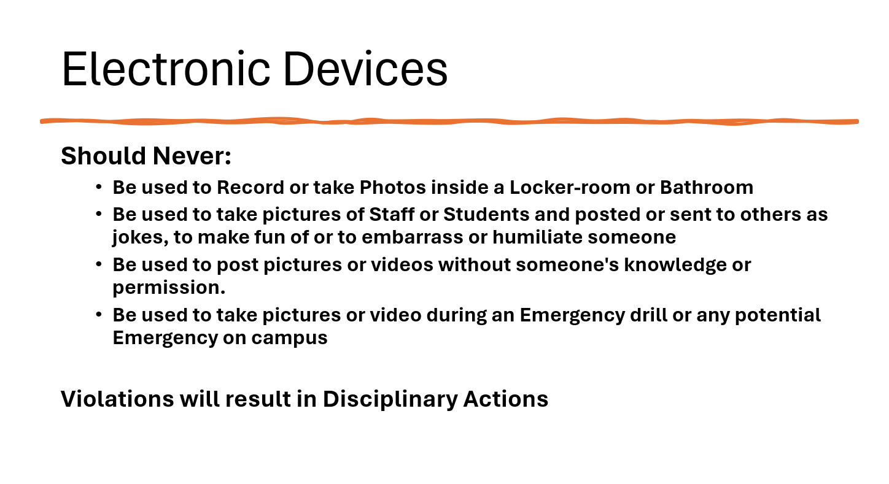

Slide 16
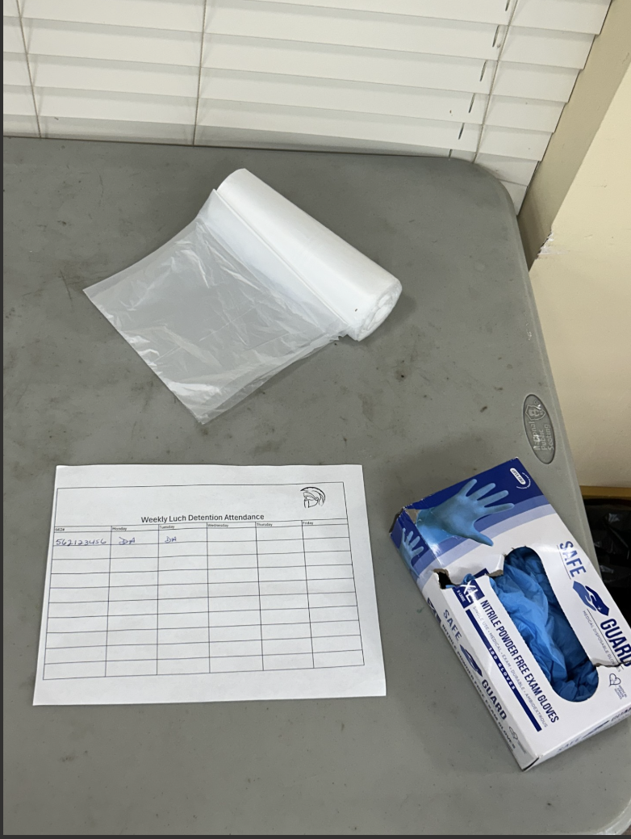


NEW Lunch Detention Procedure
Lunch detention will be the entire week Monday to Friday
Each day at 12:20 students need to report to the cafeteria
Initial the sign in sheet for the day
Retrieve 1 glove and 1 bag from table inside cafeteria
Assist with picking up trash and trays left behind by students around campus
Cameras will be reviewed to ensure Detention was served.

Slide 17
Student Parking
Only students with a parking permit may park on campus.
1st Violation: Warning
2nd Violation: Detention
3rd Violation: Revocation of Parking Permit
Non-Permitted Parking: TOWED at OWNERS EXPENSE

Slide 18






1938
2029
1867
House Points 2024-2025
1944
1831

Slide 19
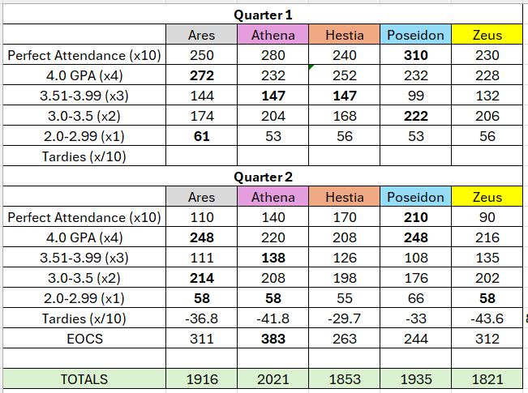
Where Your House Points Came From So Far…

Slide 20
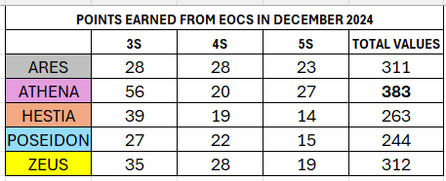
House Points From EOCs in December

Slide 21


Slide 22



ATTENTION FBA CHAPTER MEMBERS!!!!
Chapter meetings will be held on Thursdays
at lunch time in room 175.
Email Mr. Romanoski with any questions:
romanoski.jason@somersetcareeracademy.org

Slide 23


Slide 24
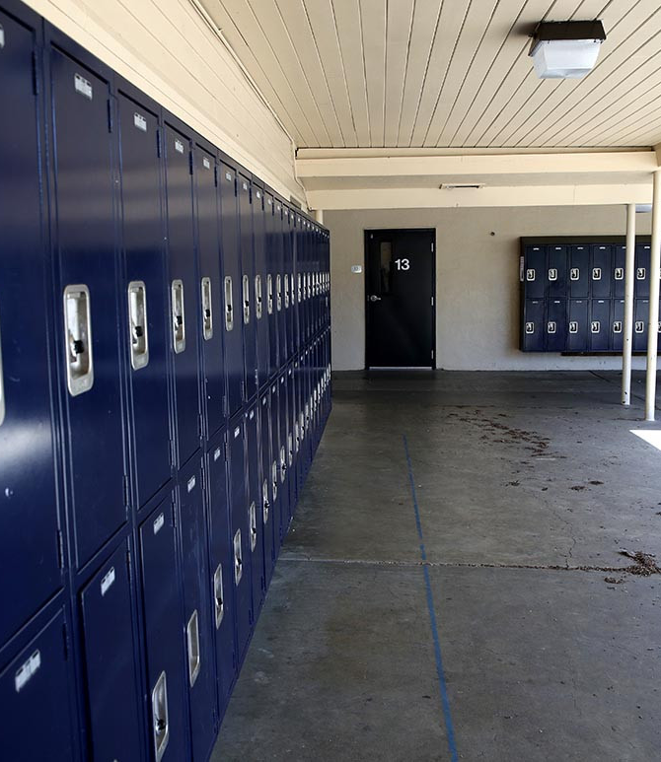
Attention Students!
If you have a lock on a locker that the front office DID NOT assign to you, It will be cut off, and the contents removed to the office.
Lockers MUST be assigned by the office only.
NO ONE is allowed to just grab a locker and put a lock on it.
The deadline to remove your lock on an unassigned locker is Thursday January 23! After this date it will be cut off.
NO exceptions!

Slide 25
Gradventure Interest Meeting
Class of 2029
Thursday January 23rd during Lunch
Room #276 (Use back Staircase Near Build Room & Basketball Court)
12 Noon (Sharp) on time
8th Graders interested in going to Universal Orlando on May 2nd 2025

Slide 26
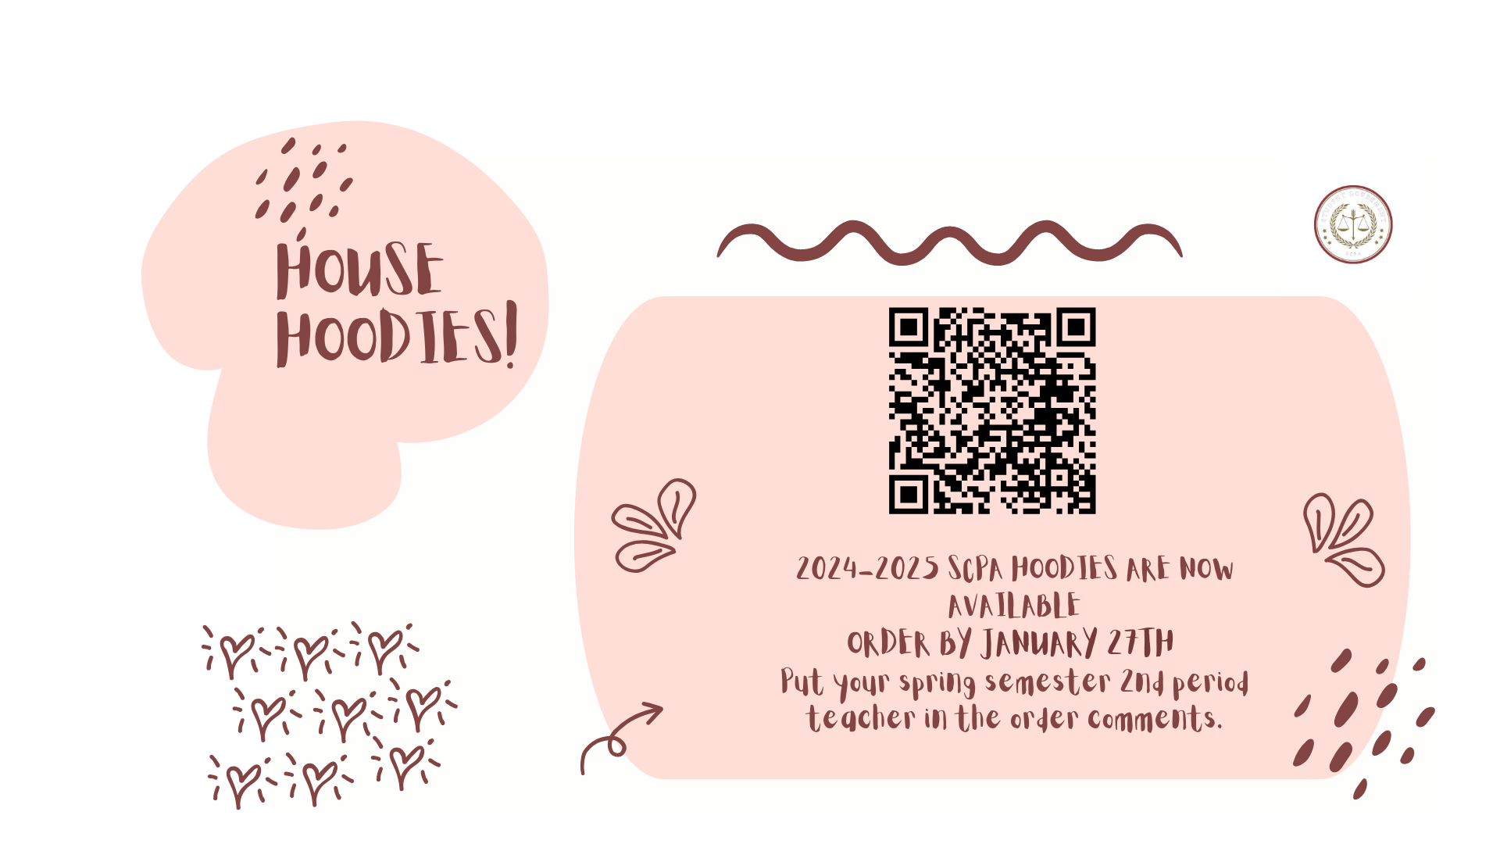

Slide 27

Win a yearbook by creating the cover(front and back) for this year's theme: Vinyl Rewind!
Email devereux.elizabeth@somersetcollegeprep.org if digital or bring physical copy to room 228

Slide 28


Slide 29

It’s Alive!
SAVE THE WORLD FROM THE DRAGON LICH …
… AT THE DUNGEONS AND DRAGONS CLUB THIS MONDAY
3:50 – 5:15
PM
ROOM 175

Slide 30
School Clubs
Chorus- Highschool: Afterschool 4-5:30 Mondays in 268C
Guitar Club- Mondays, afterschool from 4-5pm in 169C
D&D Club- Mondays, afterschool, in 175C, from 3:50-5:15
Movie Club- Mondays, at lunch in 234A
Boxing Club- Outside on the turf afterschool, on Mondays, Wednesdays, and Fridays
Florida Future Educators of America (FFEA)- Tuesdays at lunch in 164C
Artists for a Cause- Tuesdays at lunch in 268C and 2nd Wednesday of the month, afterschool in 268C
Community Service Club- Wednesdays at lunch in 232A
Student Government Association (SGA) - Wednesdays, Afterschool in 226A
Chess Club- Fridays at lunch in 234A
Chorus- Middle School: Afterschool 4-5:30 Thursdays in 265C
Science Olympiad- Fridays at lunch in 247B
First Priority- Wednesdays, at lunch, in 263C
GSA- Fridays, at lunch, in 169C

Slide 31
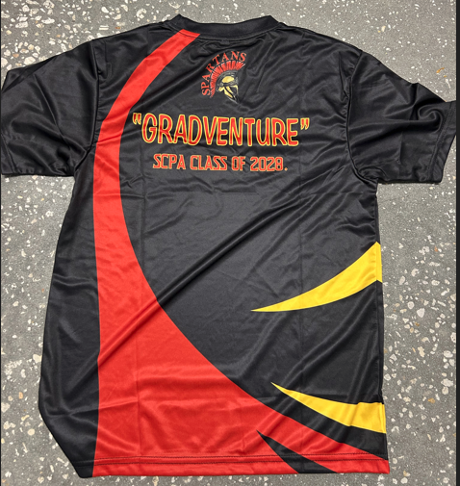
Free Gradventure Shirts
Class of 2028 ( 9th grade) ONLY
Interested!
Email Mr. Horne with your size.
(Use School email) Horne.David@somersetcollegeprep.org
All sizes available. All shirts must go.

Slide 32

Interested in starting a school club?
If you’re interested in starting a school club, you should do the following:
  Find a teacher to sponsor the club. Give them the details about the club so they know if they’re able to sponsor the club.
  Create a petition and get students who would be interested in your club to sign it. This shows that your club has generated interest.
  Talk to someone in administration about getting your club approved. Tell them who the sponsor is, when the club will occur (lunch or afterschool), and what the club entails.
  Email Mr. Kyryliw (Kyryliw.Michael@somersetcollegeprep.org) the information about you club and a slide advertising it. I will leave the advertising slide up for a week or so and create a slide listing all the club information for easy reference.

Slide 33
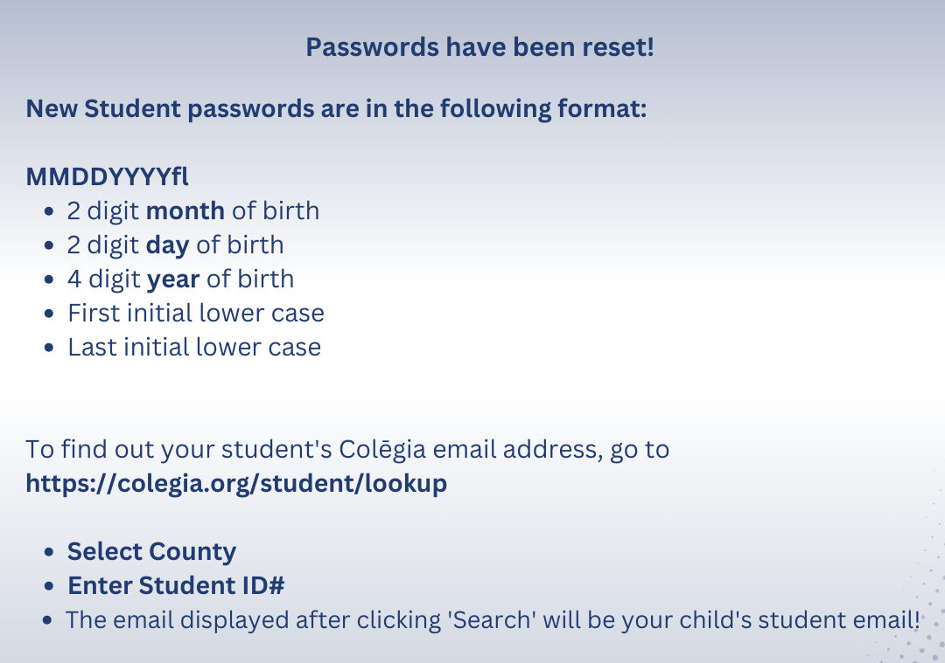

Slide 34


Somerset College Prep &Public Wireless ACP Program
This document will also be in the front office for you to scan the QR code.

